Slide 1
VR Knowledge Oculus Mobile Tuning Tech Note
Andy Chen
Prerequisite: Basic OpenGL

Slide 2
Outline
Basic VR Knowledge
Oculus Mobile Tuning Performance Tech Note

Slide 3
Virtual Reality Basic Knowledge
Convex Lens
Distortion Shader Effect
Stereoscopic Rendering

Slide 4
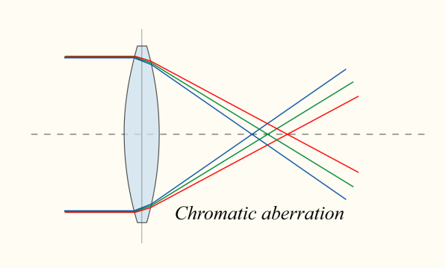
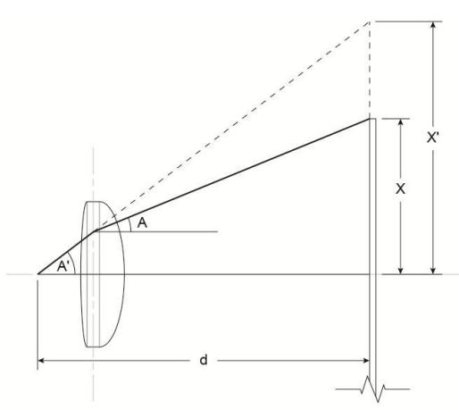
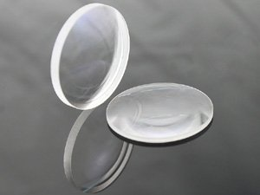
Convex Lens
Convex Lens Has Lens Distortion Problem
Need to be solved ? Ans: distortion effect
Convex Lens other problems
https://en.wikipedia.org/wiki/Optical_aberration
Distortion
Chromatic aberration

Slide 5
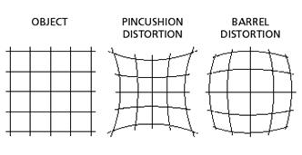
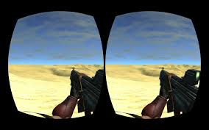
Convex Lens Distortion
https://www.youtube.com/watch?v=B7qrgrrHry0

Slide 6
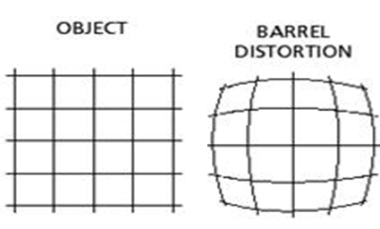
Barrel Distortion Shader Effect
Two types of shader
fragment shader
vertex shader
http://www.geeks3d.com/20140213/glsl-shader-library-fish-eye-and-dome-and-barrel-distortion-post-processing-filters/2/
The distortion effect related with lens

Slide 7
Stereoscopic Rendering
Simulate human eye because of parallax
Binocular vision to create depth perception
Binocular distance (approx 6~6.5cm)
Use two camera as left eye and right eye
two camera distance called as “Interaxial”

Slide 8
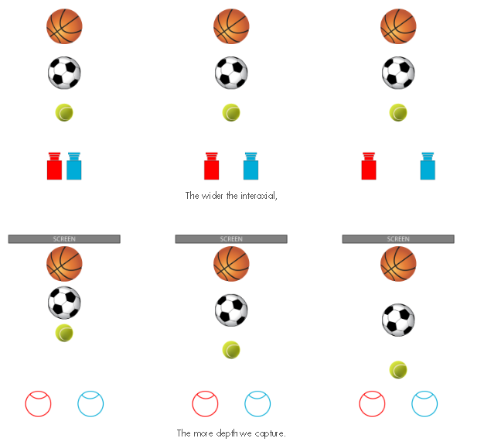
Interaxial

Slide 9
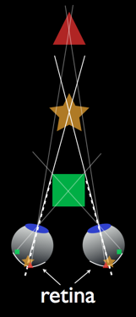
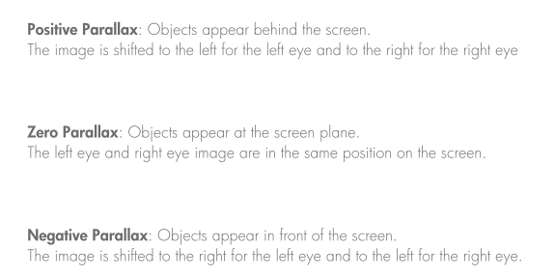
Screen Parallax
Convergence Distance

Slide 10
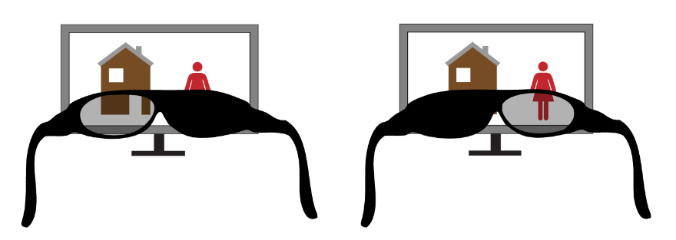
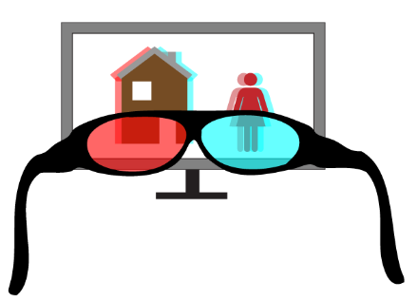
3D Glasses

Slide 11
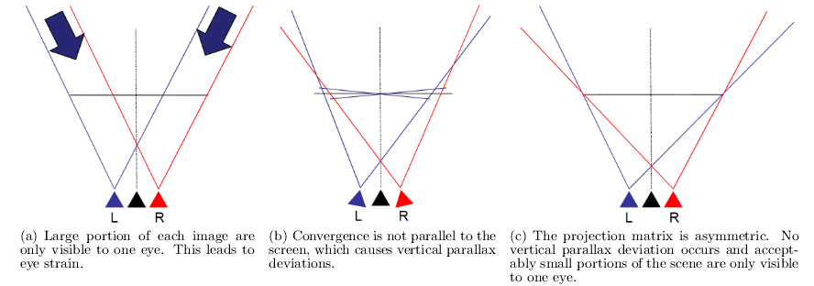
Convergence (1/2)

Slide 12
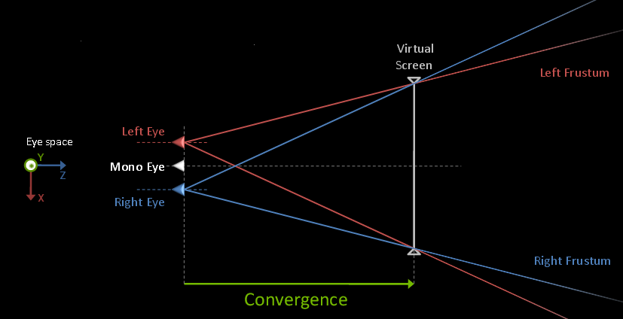
Convergence (2/2)

Slide 13
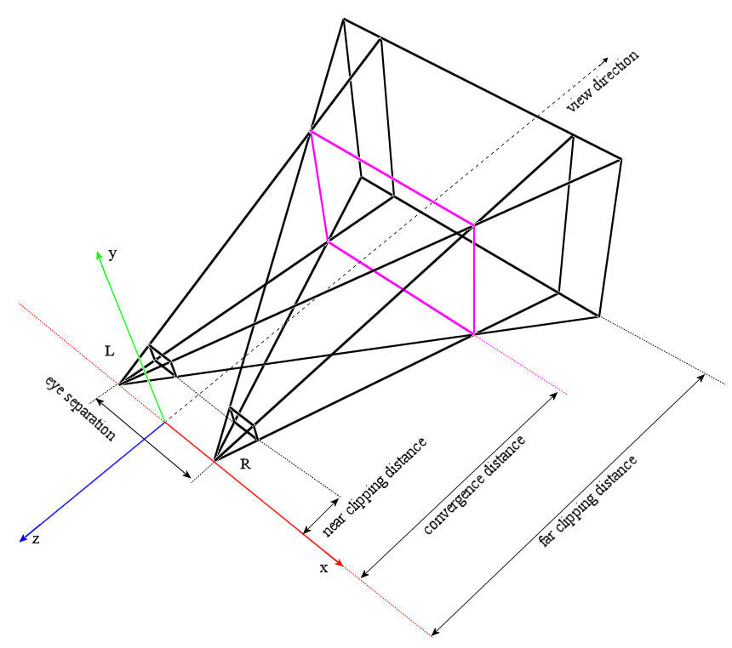
General Geometry vs Stereoscopic Geometry
1. Mono camera frustum is symmetric, gluPerpective (FOV and Aspect ratio)
2. Left & right camera frustum is asymmetric, need to calculate and apply to glFrustum
3. For calculation, need get mono camera FOV and aspect ratio
4. calculate top, bottom, left and right plane by using FOV and aspect ratio
5. gluLookAt from left and right camera is different, lookAt center point shift based on mono camera look at center point
gluLookAt
mono camera

Slide 14
OpenGL Stereoscopic Rendering
Get Left and Right Camera Geometry
(Get left and right frustum)
Convergence
Eye separation
Aspect ratio
FOV Y degree
Near
Far
Render each camera view to FBO
get FBO color texture
Prepare plane subdivision mesh
apply distortion effect with camera texture
Maybe apply chromatic aberration in fragment shader
Swap buffer for double buffer
or glFlush for single buffer

Slide 15
Oculus Mobile Tech Note
How Oculus Mobile Tune Performance

Slide 16
Linux Scheduling
http://man7.org/linux/man-pages/man7/sched.7.html
change thread to SCHED_FIFO
change thread priority
change thread CPU affinity

Slide 17
VRManager in System Server
reportApplicationInVR( String pkg, boolean activeInVR )
VR activity should heartbeat to VRManager to check if VR acitivity normal because of VR activity change to FIFO that may cause hang
setThreadSchedFifo( String pkg, int pid, int tid, int prio );
setCPUClockMhz( String pkg, int[] mhz )
setGPUClockMhz( String pkg, int mhz );
releaseCPUMhz( String pkg)
releaseGPUMhz( String pkg)
// CPU mhz: 300,423,653,730,884,960,1037,1191,1268,1498,1575,1728,1959
( 2266,2458 not supported by VrManager)
// GPU mhz: 200,320,389,462,578

Slide 18
VR Lib listen to Vsync
Each event register broadcast receiver, and then onReceive calls native function to native code
Headset Plug
Battery
Wi-fi
Phone state
Volume
Get VRManager proxy to set CPU & GPU clocks

Slide 19
Tune Performance
Query Object
Query GPU time
https://www.opengl.org/wiki/Query_Object
https://www.khronos.org/registry/gles/extensions/EXT/EXT_disjoint_timer_query.txt
To Make Low Latency
Front Buffer Rendering (Direct Rendering)
Time Warp
https://www.youtube.com/watch?v=WvtEXMlQQtI
Sensor Head Tracking Prediction
Related with sensor latency, angular velocity, linear velocity

Slide 20
Front Buffer Rendering
VRSurfaceManager in system server
setFrontBuffer
DirectRender.cpp
Consider tile rendering condition for different GPU platform
Tile render half screen for each eye
Force call glScissor half screen
Half screen as a bin
https://www.khronos.org/registry/egl/sdk/docs/man/html/eglCreateWindowSurface.xhtml
Create a single buffer

Slide 21
TimeWarp
Solve the head tracking not sync with rendering
Solve the final head tracking, the image not drawn, and then predict final image based on previous image
TimeWarp is not panacea, it is just approximate image that may cause black edge image because of shifting image
Head Rotation 1
Head Rotation 2
Interpolate head rotation matrix to shift image pixels
Notes:
Many people are skeptical on first hearing about this, but for attitude changes, the warped pixels are almost exactly correct. A sharp rotation will leave some pixels black at the edges, but this turns out to be minimally distracting.

Slide 22
TimeWarp

Slide 23
TimeWarp
There two infinite loop threads
VR thread 2. Warp thread
that dedicate rendering
VR Thread
PBuffer Surface
RenderToTexture
https://www.khronos.org/registry/egl/sdk/docs/man/html/eglCreateContext.xhtml
EGLContext eglCreateContext(EGLDisplay display, EGLConfig config, EGLContext share_context, EGLint const * attrib_list)
IMG_context_priority
EGL_CONTEXT_PRIORITY_LEVEL_IMG 0x3100
EGL_CONTEXT_PRIORITY_HIGH_IMG 0x3101
EGL_CONTEXT_PRIORITY_MEDIUM_IMG 0x3102
EGL_CONTEXT_PRIORITY_LOW_IMG 0x3103
Share
eglContext
use this texture to draw to the surface
Warp Thread
Window
Surface
Draw Surface
High priority to use glContext

Slide 24
TimeWarp
vsync
tex means texture
VR thread
Warp thread
Block until
warp thread render someone eye
generate new texture
thread crash
draw so long
drop fps
still can work
Left eye
Right
eye
Left eye
Right
eye
Left eye
Right
eye
Left eye
Right
eye
Left eye
Right
eye
Left eye
Right
eye
previous left eye tex
new right eye tex
new left eye tex
new left eye tex
new left eye tex
previous left eye tex
previous left eye tex
previous right eye tex
new right eye tex
new right eye tex
new right eye tex
previous right eye tex

Slide 25
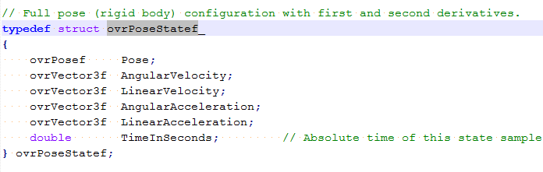
TimeWarp
Each eye image records its texture and transform
That can use timewarp to predict the real image

Slide 26
TimeWarp

Slide 27
TimeWarp
Predict Head Tracking
return predicted sensor pose
TimeWarp.cpp
Calculate warp rotation matrix
Calculate the warp rotation matrix given to program

Slide 28
Head Tracking Prediction
OVR_CAPI.cpp
CAPI_HMDState.cpp
OVR_SensorFusion.cpp

Slide 29
Distortion Effect related with Lens
OVR_DeviceConstants.h
Enum DistortionEqnType
Distortion.cpp
OVR_Stereo.h
Struct LensConfig
OVR_Stereo.cpp
HmdInfo.cpp
Directly point device lens config

Slide 30
Others
Chromatic Aberration
Detail in TimeWarp.cpp shader code
sRGB FrameBuffer
glEnable( GL_FRAMEBUFFER_SRGB_EXT )

Slide 31
Performance & Power Consumption Suggestion
Don't use alpha tested / pixel discard transparency
Don't require a lot of cut out geometry
CPU (1191 MHz), GPU (389 MHz)
If 3D video CPU (884 MHz), GPU(240 MHz)
Don’t use chromatic aberration correction on TimeWarp.
Don’t use 4x MSAA.
Reduce the eye target resolution.
Using 16-bit color and depth buffers may help.
Always make sure textures are compressed and mipmapped.
Apps should always use the multithread
Make low fps such as 30 fps

Slide 32
Conclusion OpenGL Stereoscopic Rendering with TimeWarp
There are two dedicated render threads (infinite loop)
VR thread (responsible for generating new eye pose texture )
Warp thread (high priority thread) (base on VR thread generating eye texture, apply distortion effect and render to window surface)
VR thread (render to texture)
Get Left and Right Camera Geometry
Render each eye FBO to texture
Warp thread
Prepare plane subdivision mesh
apply distortion effect with camera texture
Maybe apply chromatic aberration in fragment shader
Swap buffer for double buffer or glFlush for single buffer

Slide 33
Reference
http://www.bigeye.url.tw/big5/d_opticstru.htm
http://www.app01.com.tw/paper/254fa6fd-012e-419b-8388-f3853f898ed9
http://rifty-business.blogspot.tw/2013/08/understanding-oculus-rift-distortion.html
https://www.youtube.com/watch?v=B7qrgrrHry0
http://www.uni-koeln.de/~al001/radcor_files/hs100.htm
http://blog.xuite.net/raibura/dorama/51587304-%E6%94%9D%E5%BD%B1+-+%E6%A1%B6,+%E6%9E%95,+%E9%AC%8D+%E7%8B%80+distortion+(%E8%AE%8A%E5%BD%A2)

Slide 34
Reference
http://www.animesh.me/2011/05/rendering-3d-anaglyph-in-opengl.html
http://www.geeks3d.com/20140213/glsl-shader-library-fish-eye-and-dome-and-barrel-distortion-post-processing-filters/2/
https://www.youtube.com/watch?v=WvtEXMlQQtI
http://on-demand.gputechconf.com/gtc/2015/presentation/S5668-Nathan-Reed.pdf
http://gamedev.stackexchange.com/questions/58408/how-would-you-implement-chromatic-aberration
https://developer.oculus.com/blog/asynchronous-timewarp-examined/

